Slide 1









OO Design Patterns
Overview: Creational, Structural and Behavioral Patterns for OO Design
Svetlin Nakov
Technical Trainer
www.nakov.com
Software University
http://softuni.bg

Slide 2

Table of Contents
What are Design Patterns?
Types of Design Patterns
Creational Patterns
Structural Patterns
Behavioral Patterns
Other Patterns

Slide 3
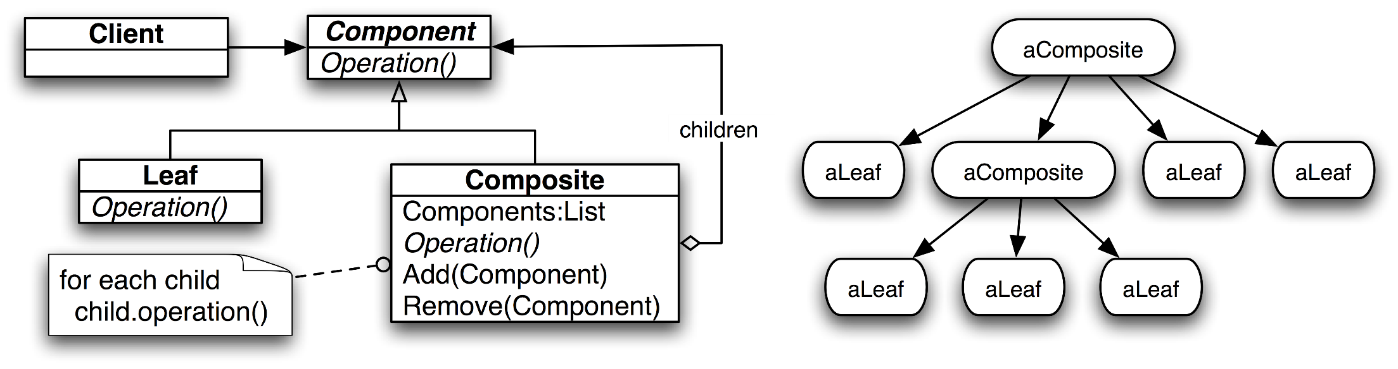
What are Design Patterns?
Name, Problem, Solution and Consequences

Slide 4
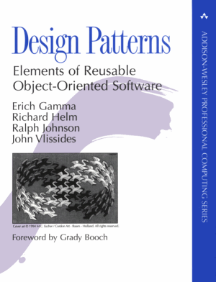
What is a Design Pattern?
Software design pattern
Reusable solutions to common problems in software design
Problem / solution pairs within a given context
A template or recipe for solving certain software design problems
GoF patterns
Classical object-oriented design patterns book by Gama, Helm, Johnson, Vlissides 1995
The "Gang of Four Book"
Creational, structural and behavioural patterns

Slide 5
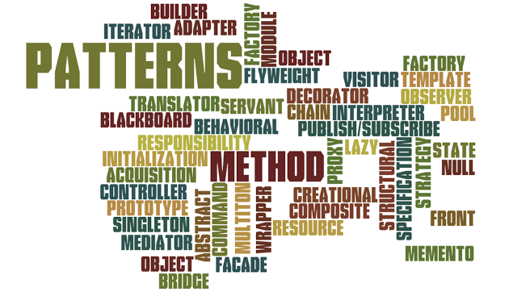
Elements of Design Patterns
Design patterns are described by a few essential elements:
Pattern Name
Increases vocabulary of designers
Problem
Intent, context, when to apply
Solution
UML-like structure, abstract code
Consequences
Results and tradeoffs

Slide 6
Design Patterns – Resources
GoF Book
Pattern Hatching: Design Patterns Applied
http://www.amazon.com/dp/0201432935/
.NET Design Patterns (with real-life examples)
http://www.dofactory.com/net/design-patterns
TutorialsPoint
http://www.tutorialspoint.com/design_pattern/adapter_pattern.htm
Design Patterns / Anti-patterns (Skookum, GitHub)
https://github.com/Skookum/design-patterns

Slide 7
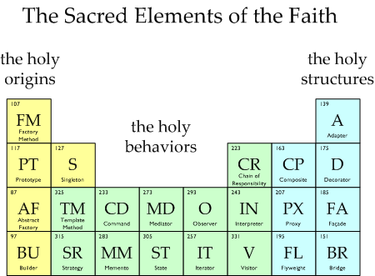
Types of Design Patterns

Slide 8
Three Main Types of OO Design Patterns
Creational patterns
Deal with initializing and configuring classes and objects
Structural patterns
Describe ways to assemble objects to implement a new functionality
Composition of classes or objects
Behavioral patterns
Deal with dynamic interactions among societies of classes and objects
How they distribute responsibilities

Slide 9
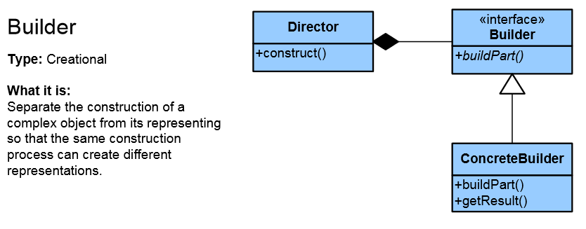
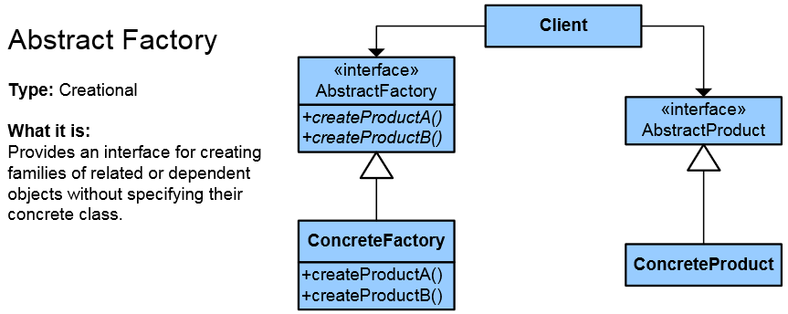
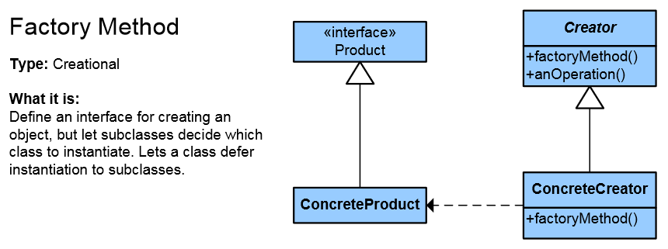
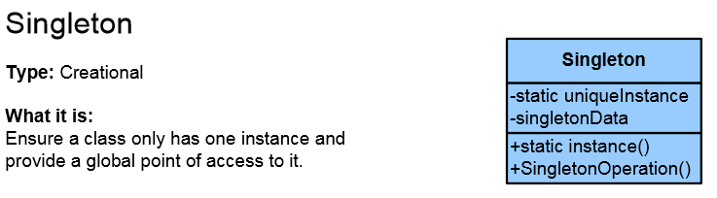
Creational Patterns

Slide 10
Creational Patterns
Deal with object creation mechanisms
Trying to create objects in a manner suitable to the situation
Instead of "new SomeClass()" use "pattern.Create()"
Composed of two dominant ideas
Encapsulating knowledge about which concrete classes the system uses
Hiding how instances of these concrete classes are created and combined

Slide 11
Singleton Pattern
The Singleton class is a class that is supposed to have only one (single) instance
Usually created on demand (lazy loading)
Sometimes Singleton is wrongly thought of as a global variable
It is not!
Possible problems:
Thread-safe

Slide 12
Singleton – Example
public sealed class Singleton
{
private Singleton() { }
private static readonly Singleton instance = new Singleton();
public static Singleton Instance
{
get
{
return instance;
}
}
}

Slide 13
Factory
In object-oriented programming, a Factory is an object for creating other objects (alternative constructor)
Not a GoF pattern; often mistaken with the Factory Method
Traditional object creation: new + constructor call
Creating objects through factory (usually a static method):
DateTime t = new DateTime(2014, 10, 16);
DateTime t = DateTime.Now;
Color c = Color.FromArgb(120, 255, 0, 0);

Slide 14
Factory – Example
public class Complex
{
private double real;
private double imaginary;
public static Complex FromPolarFactory(double modulus, double angle)
{
return new Complex(
modulus * Math.Cos(angle), modulus * Math.Sin(angle));
}
private Complex(double real, double imaginary)
{
this.real = real;
this.imaginary = imaginary;
}
}
Complex complexNum = Complex.FromPolarFactory(1, Math.PI / 3);

Slide 15
Factory: Variants
Factories may have many variants
Static / non-static method for creating products
Return the product class / product subclass
Factory inside / outside the product class
Example:
Coffee class – holds a mix of coffee and milk
CoffeeFactory class – creates coffee, cappuccino / macchiato
Depending on the coffee type requested

Slide 16
Factory Method Pattern
Factory Method
Creates objects without specifying their exact class
Crates subclasses, but returns the base abstract class / interface
Benefits
Allows adding new subclasses later
Easier extensibility
Better maintainability

Slide 17
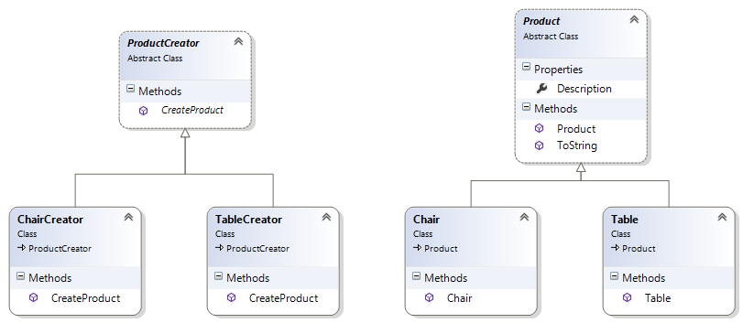
Factory Method – Example
public abstract class Product { … }
public class Chair : Product { … }
public class Table : Product { … }
public abstract class ProductCreator
{
public abstract Product CreateProduct();
}
public class TableCreator : ProductCreator
{
public override Product CreateProduct() { return new Table(…); }
}
public class ChairCreator : ProductCreator
{
public override Product CreateProduct() { return new Chair(…); }
}

Slide 18
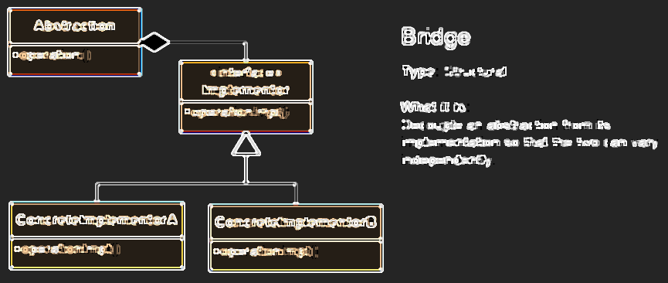
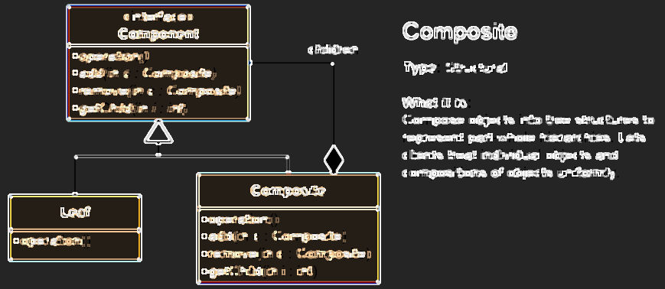
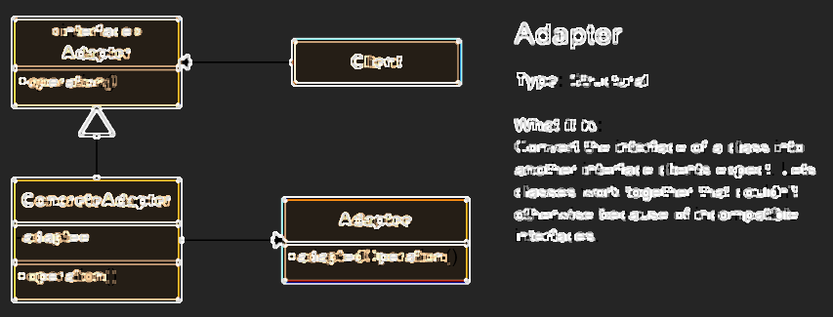
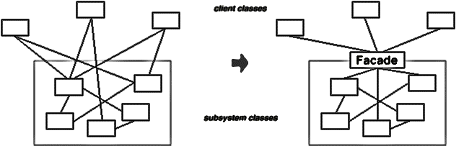
Structural Patterns

Slide 19
Structural Patterns
Structural patterns describe ways to assemble objects to implement a new functionality
Define how different classes and objects are combined to form larger structures
Structural class patterns use inheritance to compose interfaces or implementations
Structural object patterns compose objects for new functionality
Examples of structural design patterns:
Composite, Decorator, Façade, Adapter, Bridge, Proxy

Slide 20
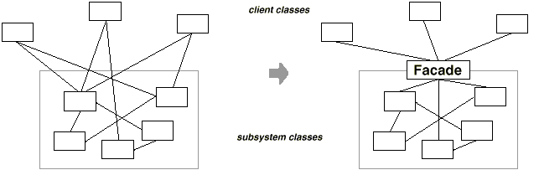
Façade Pattern
Façade provides a simplified interface to a larger body of code
Higher level interface hides the complexity of subsystems
Similar pattern: Adapter – converts between interfaces

Slide 21
Façade – Example
interface IAESFacade
{
string AESEncrypt(string message, string password);
byte[] AESEncrypt(byte[] bytesToBeEncrypted, string password);
byte[] AESDecrypt(byte[] bytesToBeDecrypted, string password);
string AESDecrypt(string encryptedMessage, string password);
}
class AESFacade : IAESFacade
{
public string AESEncrypt(string message, string password) { … }
public byte[] AESEncrypt(byte[] bytes, string password) { … }
public byte[] AESDecrypt(byte[] bytes, string password) { … }
public string AESDecrypt(string msg, string password) { … }
}

Slide 22
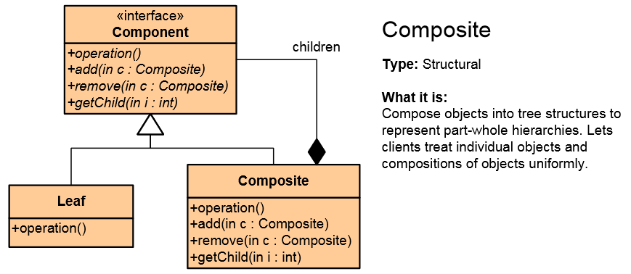
Composite Pattern
Composite Pattern allows to combining different types of objects in tree structures
Treats the same individual objects or groups of objects
Example:
Build a document system
Used when
You have different objects and you want to treat them the same way
You want to present a hierarchy of objects

Slide 23
Composite – Example
public interface IComponent { … }
public interface ICompositeComponent : IComponent
{
void Add(Component page);
void Remove(Component page);
}
public class Commander : ICompositeComponent
{
private ICollection<Component> childComponents =
new List<Component>();
public override void Add(Component component)
{ this.childComponents.Add(component); }
public override void Remove(Component component)
{ this.childComponents.Remove(component); }
}

Slide 24
Composite – Real World Examples
Controls in Windows Forms
Class System.Windows.Forms.Control holds child controls
Properties Controls, HasChildren, …
Controls in ASP.NET Web Forms
Class System.Web.UI.Control holds child controls
Property Controls
Controls in AWT / Java Swing
Classes java.awt.Component, java.awt.Container

Slide 25
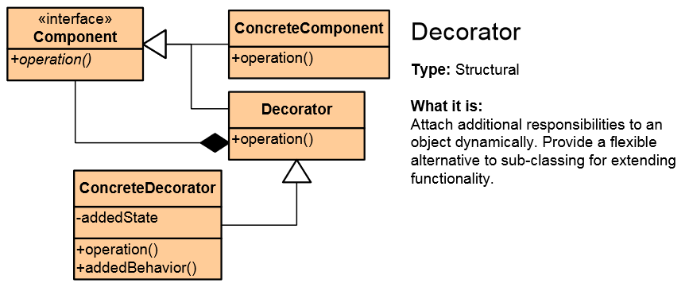
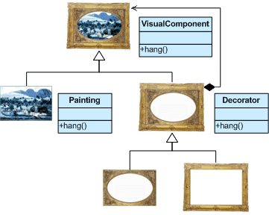
Decorator Pattern
Decorator adds responsibilities to objects dynamically
Wrapping original component
Alternative to inheritance (class explosion)
Supports the Open-Closed principle

Slide 26
Decorator – Example
public abstract class Pizza
{
public abstract string GetDescription();
public abstract decimal GetPrice();
}
public class TomatoSaucePizza : Pizza
{
private Pizza basePizza;
public TomatoSaucePizza(Pizza pizza)
{ this.basePizza = pizza; }
public override string GetDescription()
{ return this.basePizza.GetDescription() + " + Tomato Sauce"; }
public override decimal GetPrice()
{ return basePizza.GetPrice() + 0.60m; }
}

Slide 27
Decorator – Real World Examples
BufferedStream in .NET decorates Stream
CryptoStream decorates Stream
BufferedReader in Java
CryptoStream crStream = new CryptoStream(stream,
encryptor, CryptoStreamMode.Write);
BufferedReader bufferedReader =
new BufferedReader(
new InputStreamReader(
new FileInputStream(
new File("file_name.txt"))));

Slide 28
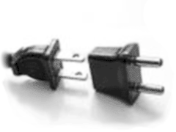
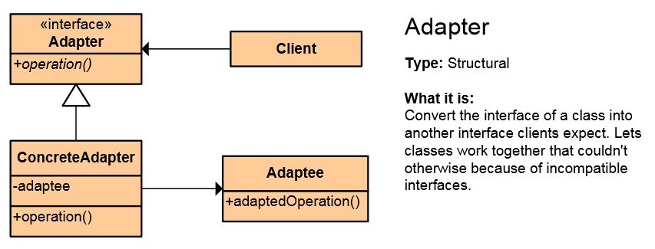
Adapter Pattern
Adapter converts the given class' interface into another class requested by the client
Wrap an existing class with a new interface
Impedance match an old component to a new system
Allows classes to work together when this is impossible due to incompatible interfaces

Slide 29
Adapter – Example
Legacy class
class ChemicalDatabank
{
public float GetMolecularStructure(string compound) {…}
…
}
interface ICompound
{
void Display();
}
Needed interface
public RichCompound : ICompound
{
public RichCompound(string compound) {
var chemicalBank = new ChemicalDatabank();
}
public void Display() {…}
}
Adapter class

Slide 30
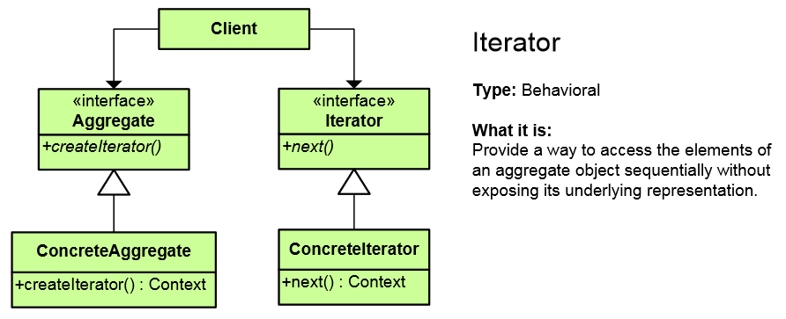
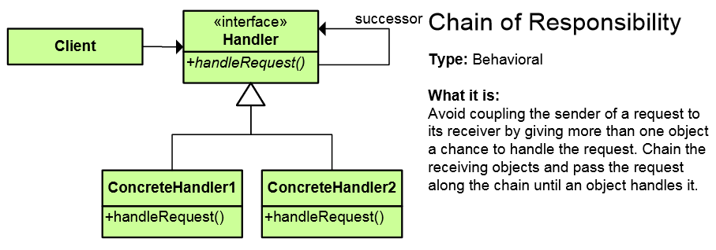
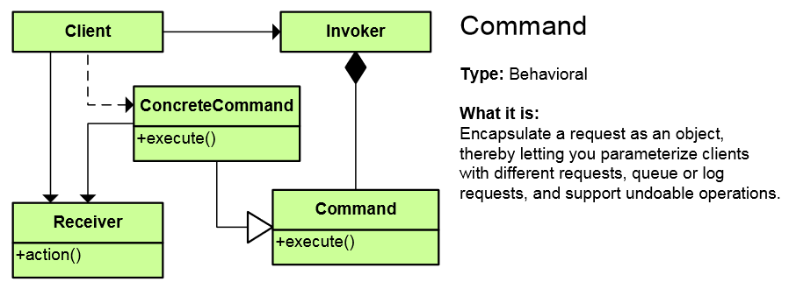
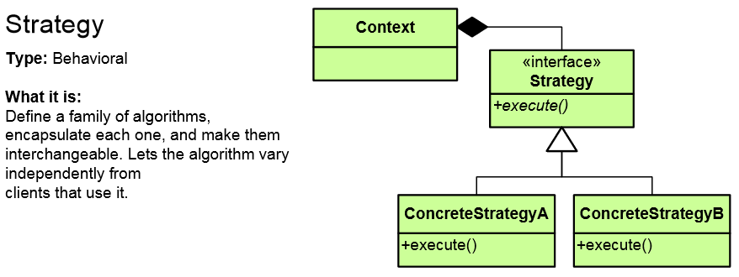
Behavioral Patterns

Slide 31
Behavioral Patterns
Behavioral patterns are concerned with communication (interaction) between the objects
Either with the assignment of responsibilities between objects
Or encapsulating behavior in an object and delegating requests to it
Increase flexibility in carrying out cross-classes communication
Classical behavioral patterns:
Chain of Responsibility, Command, Interpreter, Iterator, Mediator, Memento, Null Object, Observer, State, Strategy, Template Method, Visitor

Slide 32
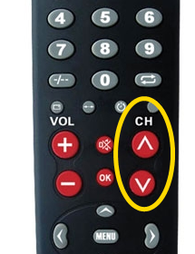
Iterator Pattern
Iterator allows access to the elements of a complex object without revealing its actual presentation
Various ways of data structure traversing
Unified interface for iterating over various data structures

Slide 33
Iterator – Example
public interface IEnumerator {
bool MoveNext();
object Current { get; }
void Reset();
}
public interface IEnumerable {
IEnumerator GetEnumerator();
}
private class ConcreteEnumerator : IEnumerator {
// Implement IEnumerator interface
}
var enumerator = someObject.GetEnumerator();
enumerator.Reset();
while (enumerator.MoveNext()) {
// Process the enumerator.Current
}

Slide 34
Iterator – Real World Examples
IEnumerable<T> / foreach in C#
Iterable<T> in Java
IEnumerator<T> GetEnumerator()
{ foreach(var element in this.array)
{
yield return element;
}
}
public boolean hasNext() { if (count < str.length()) { return true; }
else return false;
} public Character next() { return str.charAt(count++);
}

Slide 35
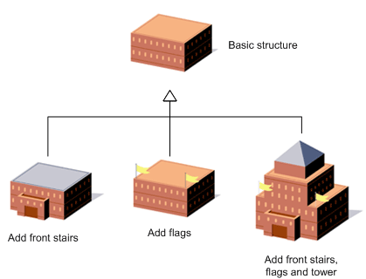
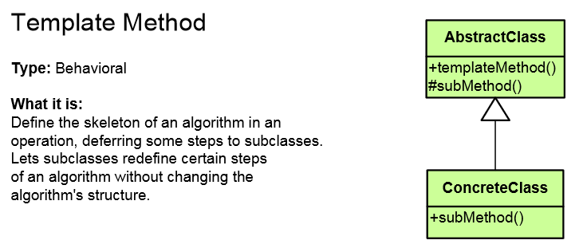
Template Method Pattern
Template Method defines the base of an algorithm in a method, leaving some implementation to its subclasses
Allows the subclasses to redefine the implementation of some of the parts of the algorithm
Doesn’t let the subclasses to change the algorithm structure

Slide 36
Template Method – Example
public abstract class HotDrink {
public void PrepareRecipe()
{
BoilWater(); Brew(); PourInCup(); AddSpices();
}
protected abstract void Brew();
protected abstract void AddSpices();
private void BoilWater() { ... }
private void PourInCup() { ... }
}
public class Coffee : HotDrink {
protected override void Brew() { ... }
protected override void AddSpices() { ... }
}
public class Tea : HotDrink {
protected override void Brew() { ... }
protected override void AddSpices() { ... }
}
Implemented by subclasses

Slide 37
Template Method – Real World Examples
Thread.run() in Java
Thread.Start() in .NET
Thread thread = new Thread(){
public void run() {
System.out.println("Thread is running.");
}
};
thread.start();
Thread thread = new Thread(
() => Console.WriteLine("Thread is running."));
thread.Start();

Slide 38
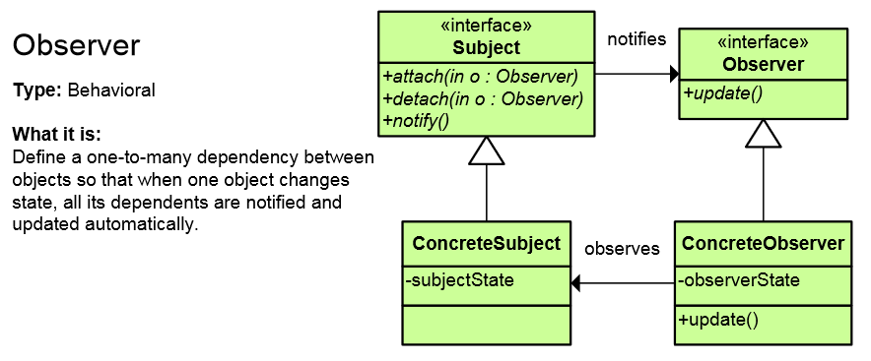
Observer Pattern
Observer presents interface, allowing object to communicate without any concrete knowledge about each other
Also known as Publish-Subscribe pattern
Object to inform other object about its state, without the knowledge which are these objects

Slide 39
Observer – Real World Examples
Events and event handlers in .NET
Events sources (components) publish events (e.g. Button)
Events in .NET provide subscribing mechanisms (e.g. Click)
java.util.Observable / java.util.Observer
Classical observer pattern
ActionListener in Java
java.awt.event.ActionListener has actionPerformed()
java.awt.Button has addActionListener()

Slide 40
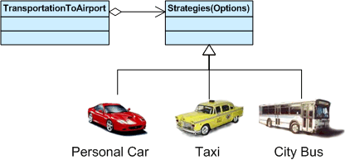
Strategy Pattern
Strategy encapsulates an algorithm inside a class
Making each algorithm replaceable by others
All the algorithms can work with the same data transparently
The client can transparently work with each algorithm

Slide 41
Strategy Pattern – Example
abstract class SortStrategy {
public abstract void Sort(IList<object> list);
}
class QuickSort : SortStrategy {
public override void Sort(IList<object> list) { … }
}
class MergeSort : SortStrategy {
public override void Sort(IList<object> list) { … }
}
class SortedList {
private IList<object> list = new List<object>();
public void Sort(SortStrategy strategy) {
// sortStrategy can be passed in constructor
sortStrategy.Sort(list);
}
}

Slide 42
Strategy – Real World Examples
IComparer<T>, Cloneable<T> in .NET
Sorting uses IComparer<T> as strategy for comparing items
The Cloneable<T> is a strategy for cloning objects
Comparer<T> in Java
Sorting uses Comparer<T> as strategy for comparing items
TreeMap<K, V> uses Comparer<T> as strategy for ordering the tree nodes

Slide 43
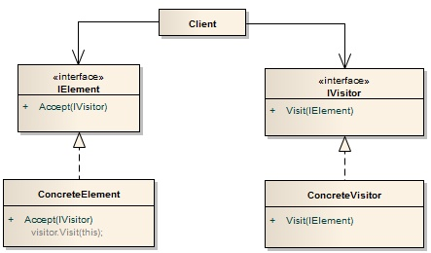
Visitor Pattern
Visitor is a way of separating an algorithm from the object on which it operates
Provides ability to add new operations to existing object structures without modifying those structures
A popular way to follow the open / closed principle

Slide 44
Visitor Pattern – Example
abstract class Visitor {
public void Visit(Element element) { … }
}
class ConcreteVisitor : Visitor {
public override void Visit(Element element) { … }
}
abstract class Element {
public abstract void Accept(Visitor visitor) { … }
}
class ConcreteElement : Element {
public override void Accept(Visitor visitor) { … }
}

Slide 45
Visitor – Real World Examples
ForEach() in .NET
Performing an action for a collection
forEach() in Java Streams
Array.prototype.forEach(function) in JavaScript
Example: Perform the same operation on a list of employees
Adjust salary
Calculate working days per month

Slide 46
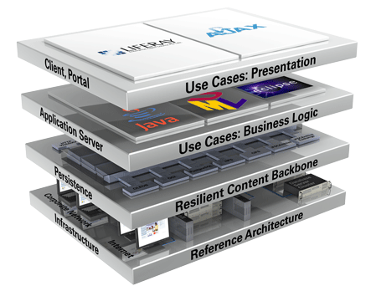
Architectural Patterns

Slide 47
Architectural Patterns
Client-Server Model – client ↔ server
3-tier Architecture – front-end ↔ logic tier ↔ back-end
Multi-tier Architecture
Model-View-Controller (MVC) – for creating UI
Model-View-Presenter (MVP) – for creating UI
Model-View-ViewModel (MVVM) – for creating UI
Front Controller – for dispatching requests in Web applications
Active Record – wrap database tables in classes + CRUD operations

Slide 48


Summary
Design patterns
Reusable solutions for common OO design problems
Creational patterns
Singleton, Factory, Factory Method
Structural patterns
Façade, Composite, Decorator, Adapter
Behavioral patterns
Iterator, Observer, Template Method, Strategy

Slide 49
OO Design Patterns
https://softuni.bg/courses/oop/

Slide 50
License
This course (slides, examples, demos, videos, homework, etc.) is licensed under the "Creative Commons Attribution-NonCommercial-ShareAlike 4.0 International" license
Attribution: this work may contain portions from
"OOP" course by Telerik Academy under CC-BY-NC-SA license

Slide 51







SoftUni Diamond Partners

Slide 52





Free Trainings @ Software University
Software University Foundation – softuni.org
Software University – High-Quality Education, Profession and Job for Software Developers
softuni.bg
Software University @ Facebook
facebook.com/SoftwareUniversity
Software University @ YouTube
youtube.com/SoftwareUniversity
Software University Forums – forum.softuni.bg

